Slide 1
CSE 3400 - Introduction to Cyber Security (aka: Computer and Information Security) Topic 2: Message Authentication and Hashing
Prof. Amir Herzberg
Dept. of Computer Science & Engineering
University of Connecticut
Last updated: 2/4/2020

Slide 2



Encryption ensures confidentiality:
k
k
m=“I love you”
E
D
m
c=E_{k}(m)
c
Monster-in-the-Middle attacker ‘learns nothing’ about message
Notes:
2
10/30/11

Slide 3
Encryption ensures confidentiality:
k
k
m=“I love you”
E
D
c=E_{k}(m)
c'
m‘=D_{k}(c’)
m’=“I hate you”
But what about authentication, integrity?
Same model: shared key, MitM attacker
Did Alice send this message (m’), i.e., m’=m ?
Does Encryption prevent forgery?
No; example?
Notes:
3
10/30/11

Slide 4
Does Encryption Prevent Tampering?
Clearly not for bitwise stream ciphers (& OTP):
given c=m⊕k, attacker can send c⊕mask, to invert any bit in decrypted message (use mask)
Exercise: Mal eavesdrops on OTP encryption of the ASCII message ``Transfer 10$ to Bob. From: Alice PW:MyBobby’’. Show how Mal can change it so the bank will transfer (maximal amount) to Mal instead.

Slide 5
Does Encryption Prevent Forgery?
Clearly not for bitwise stream ciphers (& OTP):
given c=m⊕k, attacker can send c⊕mask, to invert any bit in decrypted message (use mask)
Maybe use Error-Detecting-Code (EDC)?
EDC: easy to compute, and detects (most) errors
I.e., with high probability, EDC(m)≠EDC(m’) for random m, m’ (m≠m’)
EDC-then-Encrypt: E_{k}(m || EDC(m))
May still be insecure for some ciphers, e.g, bitwise XOR:
m | EDC(m) | (m||EDC(m))⊕k | m’ | EDC(m’) | (m’||EDC(m’)) ⊕k
000-111 | 010 | 010-011-010 | 101-000 | 110 | ???????
c
c’

Slide 6
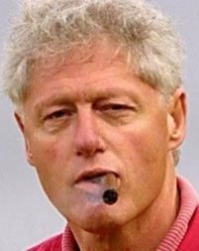
MAC authenticates messages
MAC allows a recipient to validate that a message was sent by a key holder
Valid MAC ➔ Only Bill and me know k. So he (or me…) sent m.
m=“xxx”, MAC_{k}(m)
Key k
Key k
Notes:
6
(c) Amir Herzberg, http://AmirHerzberg.com, Bar Ilan University
11/13/11

Slide 7

Message Authentication Code (MAC)
Use shared key k to authenticate messages
Pair (Tag , m) is valid iff Tag=MAC_{k}(m)
Very efficient
k = ??
MAC
k
(m
’
) = ??
xxx
m
’
+
+
(xxx
MAC
k
)
Tag ??
Bill
Alice
Key
k
Key
k
Notes:
7
(c) Amir Herzberg, http://AmirHerzberg.com, Bar Ilan University
11/13/11
Message sent together with Tag=MAC_{k}(m)
Received message, tag are valid iff Tag=MAC_{k}(m)
Efficient (often even more than shared-key encryption)
But: Alice can later deny having sent m to Bob (why?)

Slide 8
Defining MAC Security
Following the `conservative design principle’:
Consider most powerful attacker
Let attacker receive tag for every message it wants
And `easiest’ attacker-success criteria
Valid for any message
Except for these that the attacker asked to authenticate
xxx
m
’
+
(xxx
MAC
k
)
Tag ??
Bill
Alice
Key
k
Key
k
Notes:
8
(c) Amir Herzberg, http://AmirHerzberg.com, Bar Ilan University
11/13/11
Message sent together with Tag=MAC_{k}(m)
Received message, tag are valid iff Tag=MAC_{k}(m)
Efficient (often even more than shared-key encryption)
But: Alice can later deny having sent m to Bob (why?)

Slide 9
Message Authentication Code (MAC)
Use shared key k to authenticate messages
Pair (Tag , m) is valid iff Tag=MAC_{k}(m)
Very efficient
Deniable: “I never sent xxx to that woman”
k = ??
MAC
k
(m
’
) = ??
xxx
m
’
+
+
(xxx
MAC
k
)
Tag ??
Bill
Alice
Key
k
Key
k
Notes:
9
(c) Amir Herzberg, http://AmirHerzberg.com, Bar Ilan University
11/13/11
Message sent together with Tag=MAC_{k}(m)
Received message, tag are valid iff Tag=MAC_{k}(m)
Efficient (often even more than shared-key encryption)
But: Alice can later deny having sent m to Bob (why?)

Slide 10
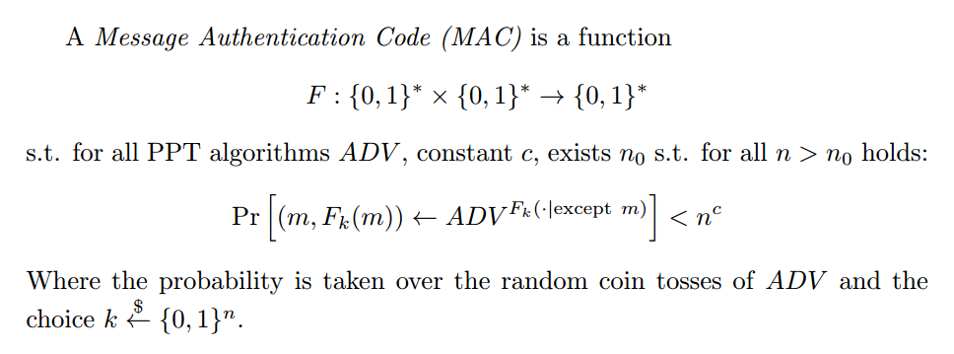

Secure MAC : Definition
Or: fixed-length range / domain
Q: what does ${ADV}^{F_{k}(∙|except m)}$ mean??
A: $ADV$can receive $F_{k}(x)$ for any x, except for x=m.
Notes:
10
(c) Amir Herzberg, http://AmirHerzberg.com, Bar Ilan University
11/13/11

Slide 11

Using MAC
MAC_{k}(m) may expose information about m!
Example: Let MAC be any secure MAC. Define MAC’_{k}(m)=MAC_{k}(m)||LSb(m), where LSb is least significant bit.
MAC shows a key-holder computed it
Could be any key holder (even recipient)…
One of Cat, Bill and me sent m.
m=“xxx”,
MAC_{k}(m)
Key k
Key k
Key k
Notes:
11
(c) Amir Herzberg, http://AmirHerzberg.com, Bar Ilan University
11/13/11

Slide 12
Using MAC
MAC_{k}(m) may expose information about m!
Example: Let MAC be any secure MAC. Define MAC’_{k}(m)=MAC_{k}(m)||LSb(m), where LSb is least significant bit.
MAC shows a key-holder computed it
Could be any key holder (e.g. recipient)… → Specify sender, recipient in message
Could be re-transmission (old)… → Add time/counter/random challenge
More later
Notes:
12
(c) Amir Herzberg, http://AmirHerzberg.com, Bar Ilan University
11/13/11

Slide 13
Constructing MAC: Three Approaches
Design `from scratch`, validate security by failure to cryptanalyze
Huge effort, risk → do only for few `building blocks`
Maybe from EDC (Error Detection Code), e.g., CRC?
Notes:
13
(c) Amir Herzberg, http://AmirHerzberg.com, Bar Ilan University
11/13/11

Slide 14
Constructing MAC from EDC ?
Error Detection Codes (EDC) detect random errors
Idea: use them for authentication, too!
How? Combine text with secret key
MAC_{k}(m)=EDC(k||m) or MAC’_{k}(m)=EDC(m||k) or…
Is this secure? Definitely not for every EDC!
Think bit-wise XOR of all bytes in m:
Detects any single-bit error
Fails to detect any even-number-of-bits (same position) error!
But maybe with a good EDC, e.g., CRC?

Slide 15
Exercise: CRC-MAC
Let CRC-MAC_{k}(m)=CRC(k||m)
Exercise: Show this is not a secure MAC
Actually, show it’s a very bad MAC: we can change an unknown message

Slide 16
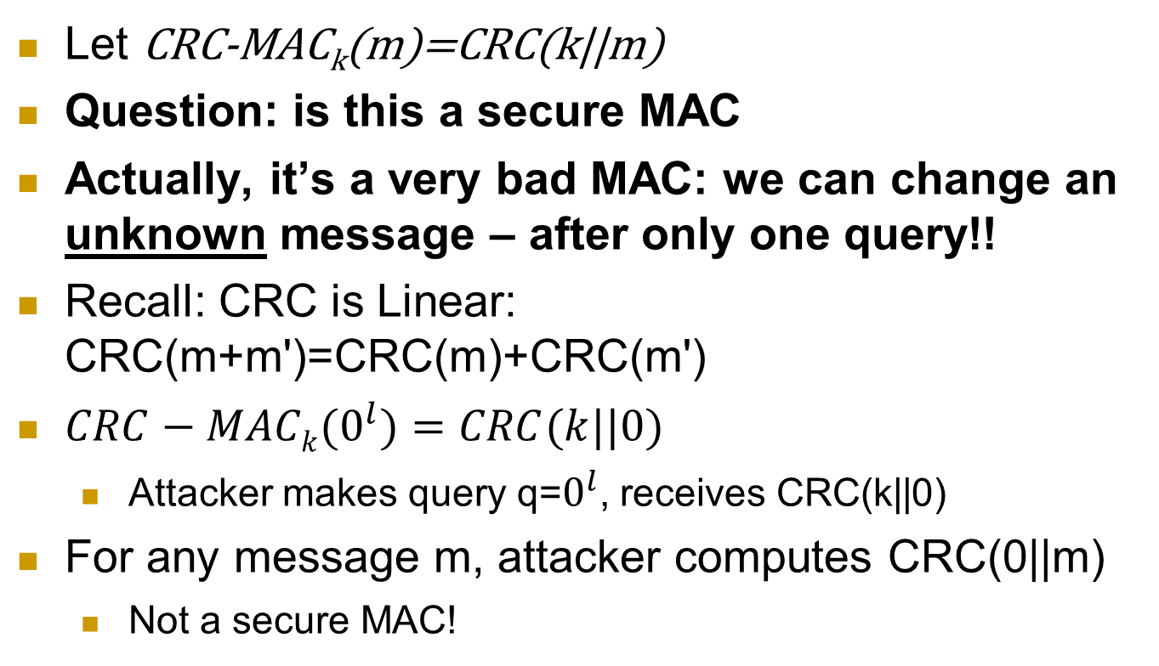
Exercise: CRC-MAC
Let CRC-MAC_{k}(m)=CRC(k||m)
Question: is this a secure MAC
Actually, it’s a very bad MAC: we can change an unknown message – after only one query!!
Recall: CRC is Linear: CRC(m+m')=CRC(m)+CRC(m')
$CRC−MACk(0^{l})=CRC(k||0)$
Attacker makes query q=$0^{l}$, receives CRC(k||0)
For any message m, attacker computes CRC(0||m)
Not a secure MAC!

Slide 17
Constructing MAC: Three Approaches
Design `from scratch`, validate security by failure to cryptanalyze
Huge effort, risk → do only for few `building blocks`
Robust combiner of (two) MAC candidates:
MAC_{k,k’}(m)=f_{k}(m)||f’_{k’}(m), MAC_{k,k’}(m)=f_{k}(m)⊕f’_{k’}(m) are secure MAC, if either f or f’ is a secure MAC.
Provable-secure constructions from…
PRF/PRP/Block ciphers (next)
First: PRF/PRP → Fixed-Input-Length (FIL) MAC
Hash functions (later)
Notes:
17
(c) Amir Herzberg, http://AmirHerzberg.com, Bar Ilan University
11/13/11

Slide 18
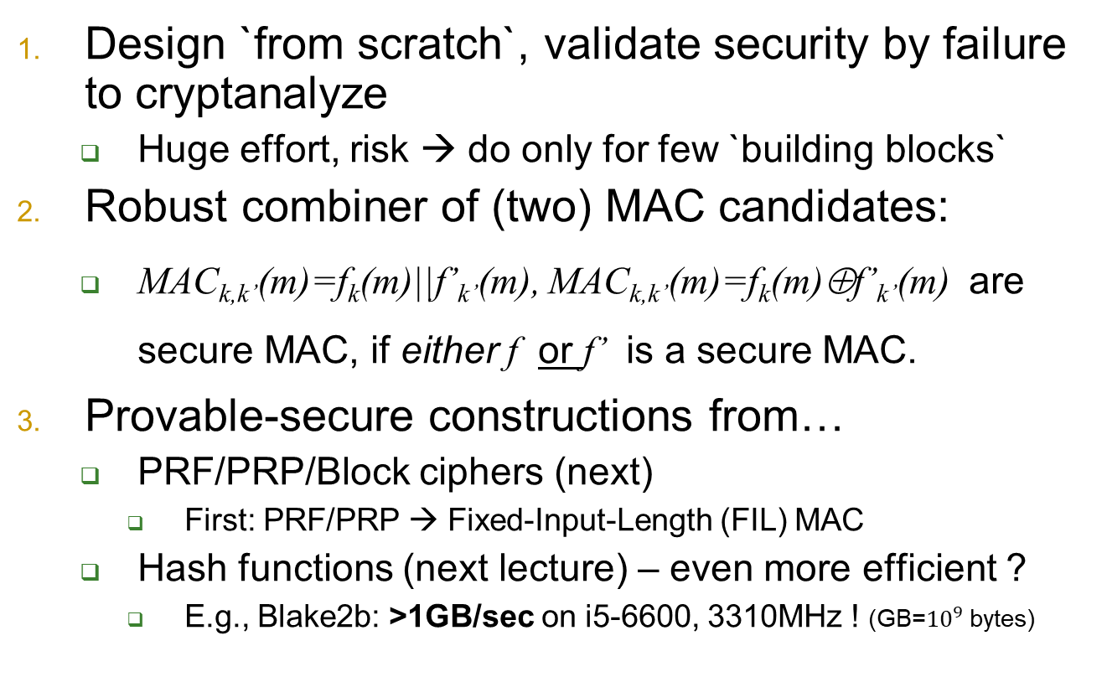
Constructing MAC: Three Approaches
Design `from scratch`, validate security by failure to cryptanalyze
Huge effort, risk → do only for few `building blocks`
Robust combiner of (two) MAC candidates:
MAC_{k,k’}(m)=f_{k}(m)||f’_{k’}(m), MAC_{k,k’}(m)=f_{k}(m)⊕f’_{k’}(m) are secure MAC, if either f or f’ is a secure MAC.
Provable-secure constructions from…
PRF/PRP/Block ciphers (next)
First: PRF/PRP → Fixed-Input-Length (FIL) MAC
Hash functions (next lecture) – even more efficient ?
E.g., Blake2b: >1GB/sec on i5-6600, 3310MHz ! (GB=${10}^{9}$ bytes)
Notes:
18
(c) Amir Herzberg, http://AmirHerzberg.com, Bar Ilan University
11/13/11

Slide 19
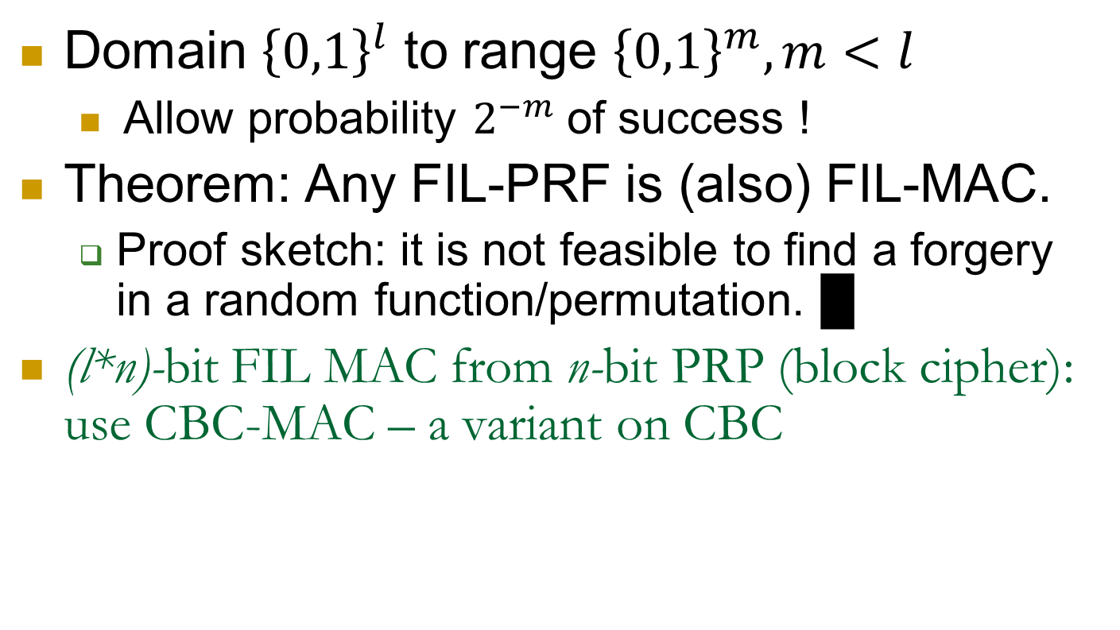
Fixed Input Length (FIL) MAC
Domain ${\left\{0,1\right\}}^{l}$ to range ${\left\{0,1\right\}}^{m}, m<l$
Allow probability $2^{−m}$of success !
Theorem: Any FIL-PRF is (also) FIL-MAC.
Proof sketch: it is not feasible to find a forgery in a random function/permutation. █
(l*n)-bit FIL MAC from n-bit PRP (block cipher): use CBC-MAC – a variant on CBC
Notes:
19
(c) Amir Herzberg, http://AmirHerzberg.com, Bar Ilan University
11/13/11

Slide 20

Cipher Block Chaining CBC-MAC
Split plaintext m to blocks m[1],…
m₁ | m₂ | … | m_{l}
Fixed, known (zero)
Initialization Vector (IV)
$$0^{n}$$
E
E
E
k
CBC-MAC[E]_{k}(m₁||m₂||..||m_{l} ) = E_{k}(m_{l}⊕E_{k}(…E_{k}(m₁))))
Widely deployed standard
More efficient ‘modes’ exist
E.g., parallel computation
Notes:
20
(c) Amir Herzberg, http://AmirHerzberg.com, Bar Ilan University
11/13/11
Parallel mode – see [BR02]

Slide 21
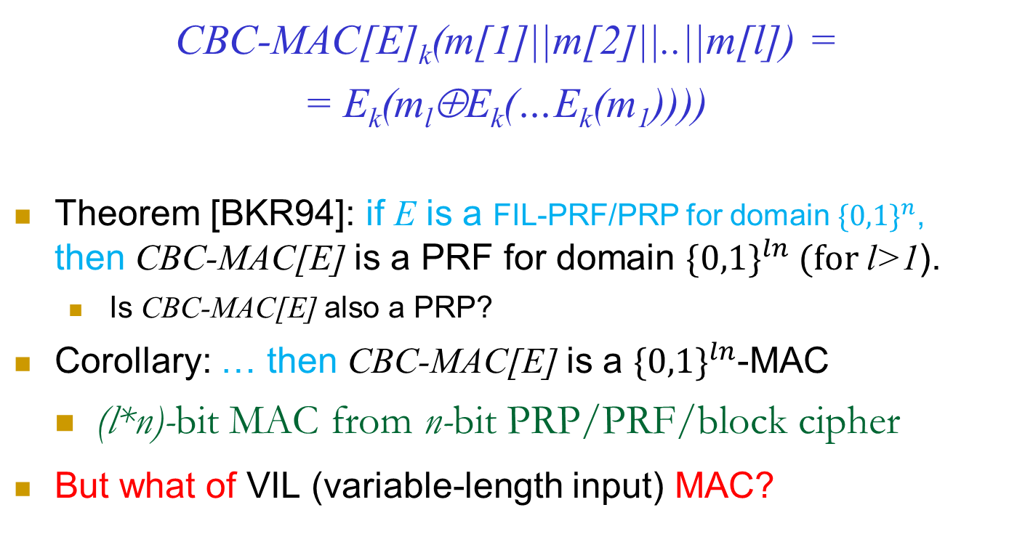
CBC MAC is a FIL PRF [BKR94]
CBC-MAC[E]_{k}(m[1]||m[2]||..||m[l]) =
= E_{k}(m_{l}⊕E_{k}(…E_{k}(m₁))))
Theorem [BKR94]: if E is a FIL-PRF/PRP for domain ${\{0,1\}}^{n}$, then CBC-MAC[E] is a PRF for domain ${\{0,1\}}^{ln} (for \text{l}\text{>}\text{1}$).
Is CBC-MAC[E] also a PRP?
Corollary: … then CBC-MAC[E] is a ${\{0,1\}}^{ln}$-MAC
(l*n)-bit MAC from n-bit PRP/PRF/block cipher
But what of VIL (variable-length input) MAC?
Notes:
21
(c) Amir Herzberg, http://AmirHerzberg.com, Bar Ilan University
11/13/11
Corollary follows from `FIL-PRF is FIL-MAC` theorem

Slide 22
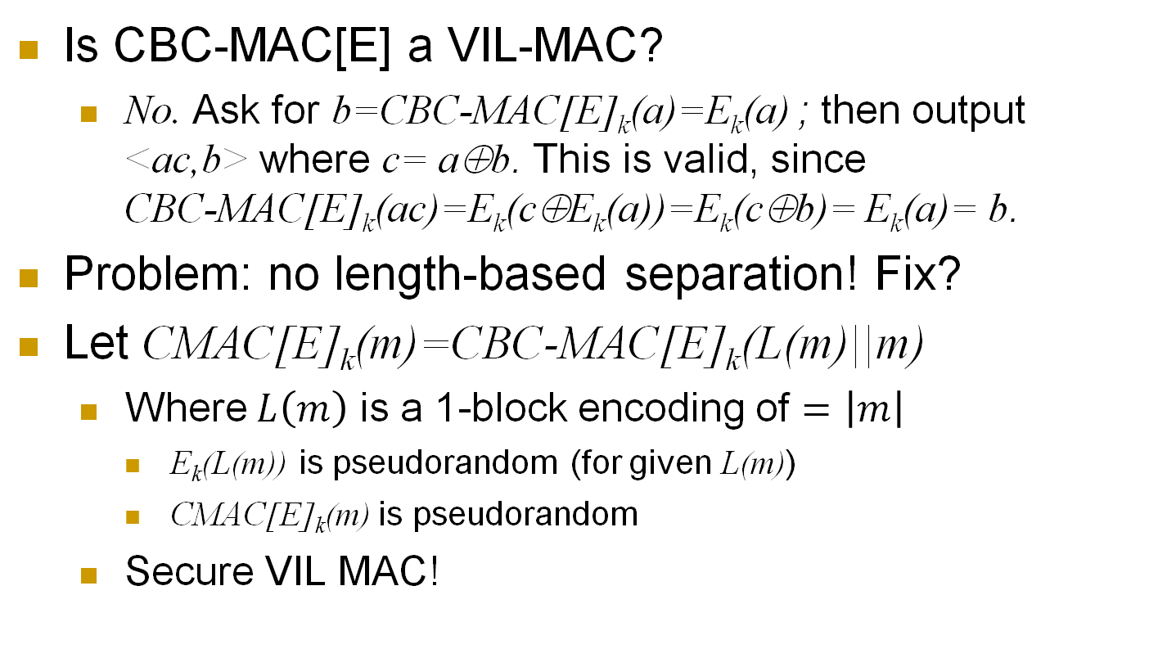

CBC-MAC-based VIL-PRF, VIL-MAC
Is CBC-MAC[E] a VIL-MAC?
No. Ask for b=CBC-MAC[E]_{k}(a)=E_{k}(a) ; then output <ac,b> where c= a⊕b. This is valid, since CBC-MAC[E]_{k}(ac)=E_{k}(c⊕E_{k}(a))=E_{k}(c⊕b)= E_{k}(a)= b.
Problem: no length-based separation! Fix?
Let CMAC[E]_{k}(m)=CBC-MAC[E]_{k}(L(m)||m)
Where $L\left(m\right)$ is a 1-block encoding of $=\left|m\right|$
E_{k}(L(m)) is pseudorandom (for given L(m))
CMAC[E]_{k}(m) is pseudorandom
Secure VIL MAC!
L(m) | m₁ | m₂ | … | m_{l}
$$0^{n}$$
E
E
E
k
Notes:
22
(c) Amir Herzberg, http://AmirHerzberg.com, Bar Ilan University
11/13/11
KR

Slide 23
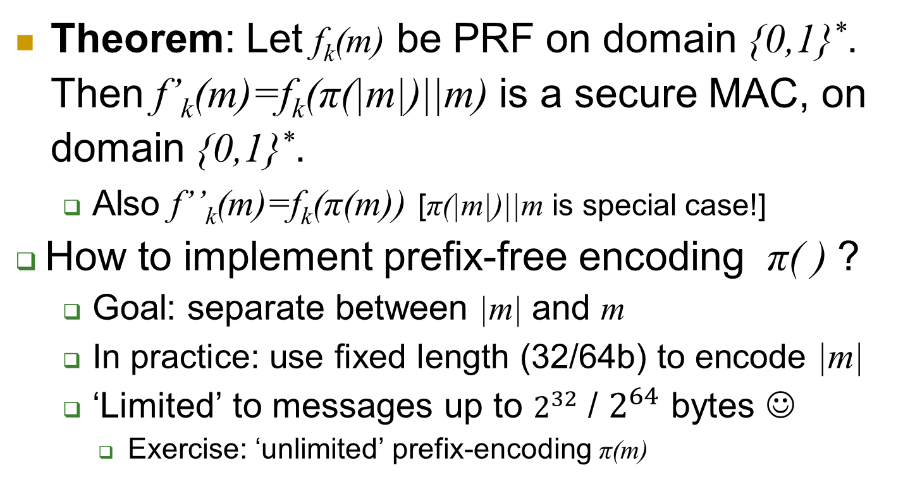
Variable Input Length MAC
Theorem: Let f_{k}(m) be PRF on domain {0,1}*. Then f’_{k}(m)=f_{k}(π(|m|)||m) is a secure MAC, on domain {0,1}*.
Also f’’_{k}(m)=f_{k}(π(m)) [π(|m|)||m is special case!]
How to implement prefix-free encoding π( ) ?
Goal: separate between |m| and m
In practice: use fixed length (32/64b) to encode |m|
‘Limited’ to messages up to $2^{32}$ / $2^{64}$ bytes ☺
Exercise: ‘unlimited’ prefix-encoding π(m)
Notes:
23
(c) Amir Herzberg, http://AmirHerzberg.com, Bar Ilan University
11/13/11
For details see http://www-cse.ucsd.edu/~mihir/papers/cbc.pdf; in particular for VIL see section 5.

Slide 24
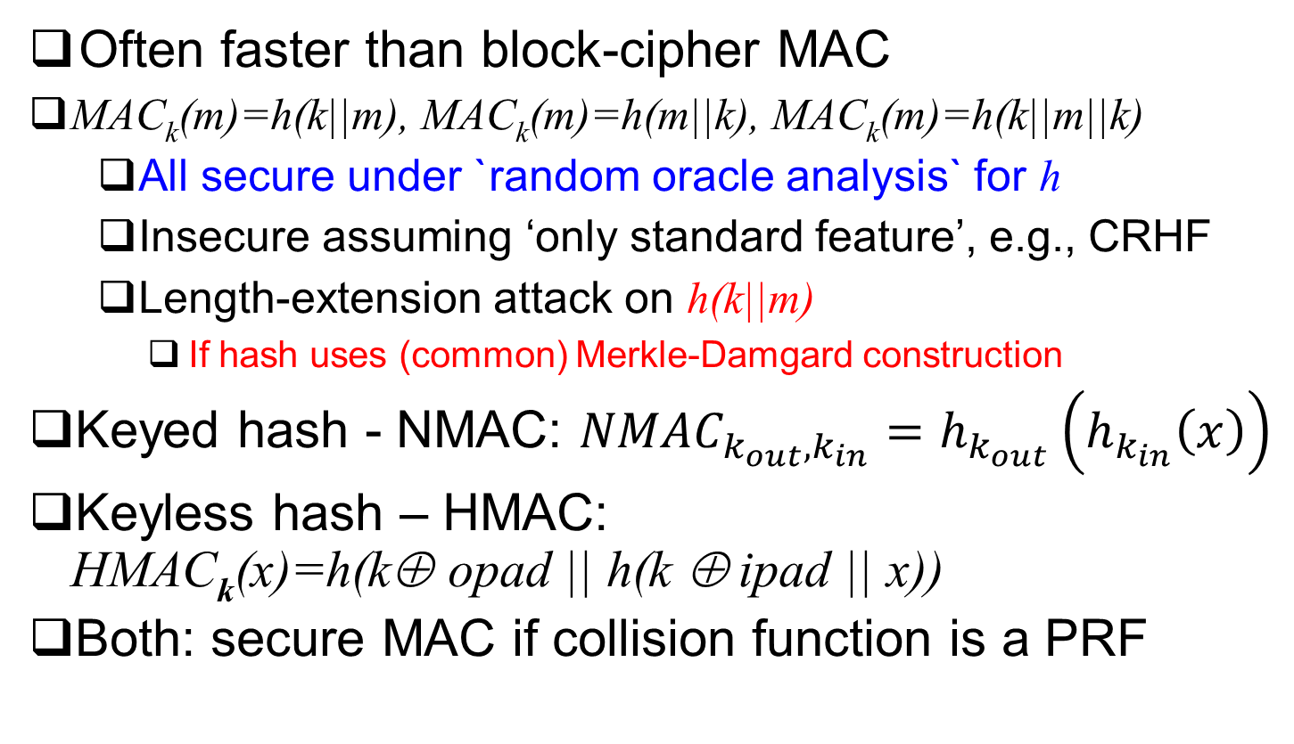
Hash based MAC
Often faster than block-cipher MAC
MAC_{k}(m)=h(k||m), MAC_{k}(m)=h(m||k), MAC_{k}(m)=h(k||m||k)
All secure under `random oracle analysis` for h
Insecure assuming ‘only standard feature’, e.g., CRHF
Length-extension attack on h(k||m)
If hash uses (common) Merkle-Damgard construction
Keyed hash - NMAC: ${NMAC}_{k_{out},k_{in}}=h_{k_{out}}\left(h_{k_{in}}\left(x\right)\right)$
Keyless hash – HMAC: HMAC_{k}(x)=h(k⊕ opad || h(k ⊕ ipad || x))
Both: secure MAC if collision function is a PRF
Notes:
24
(c) Amir Herzberg, http://AmirHerzberg.com, Bar Ilan University
04/07/06

Slide 25
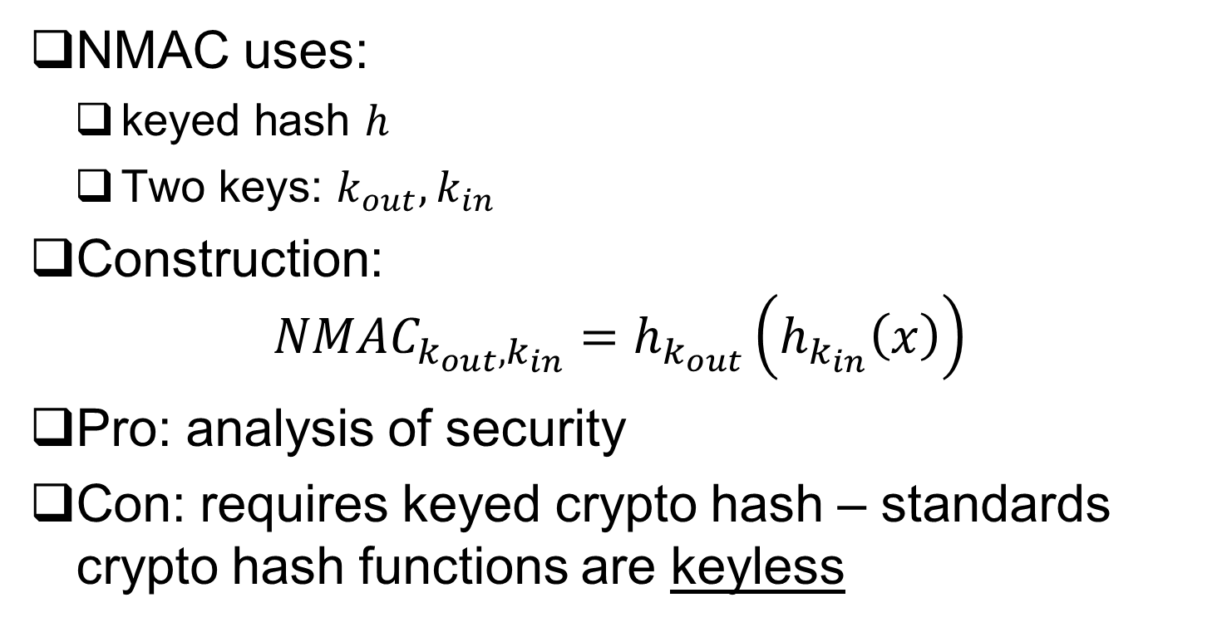
NMAC: MAC from Keyed Hash
NMAC uses:
keyed hash $h$
Two keys: $k_{out}, k_{in}$
Construction: ${NMAC}_{k_{out},k_{in}}=h_{k_{out}}\left(h_{k_{in}}\left(x\right)\right)$
Pro: analysis of security
Con: requires keyed crypto hash – standards crypto hash functions are keyless
Notes:
25
(c) Amir Herzberg, http://AmirHerzberg.com, Bar Ilan University
04/07/06
Heuristic simplification of NMAC, which has a reduction to two assumptions on the hash

Slide 26
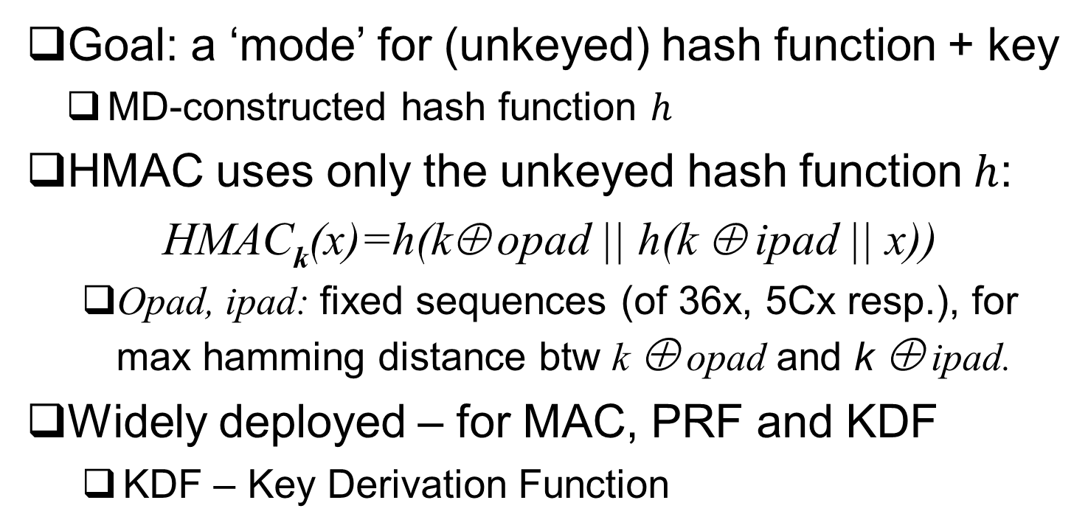
Hash-based MAC: HMAC
Goal: a ‘mode’ for (unkeyed) hash function + key
MD-constructed hash function $h$
HMAC uses only the unkeyed hash function $h$:
HMAC_{k}(x)=h(k⊕ opad || h(k ⊕ ipad || x))
Opad, ipad: fixed sequences (of 36x, 5Cx resp.), for max hamming distance btw k ⊕ opad and k ⊕ ipad.
Widely deployed – for MAC, PRF and KDF
KDF – Key Derivation Function
Notes:
26
(c) Amir Herzberg, http://AmirHerzberg.com, Bar Ilan University
04/07/06
Heuristic simplification of NMAC, which has a reduction to two assumptions on the hash

Slide 27
Finally… Authentication and Encryption
For confidentiality, use encryption
For auth/integrity, use MAC
For both confidentiality and auth/integrity?
Option 1: Combine MAC and encryption
Possible pitfalls (vulnerabilities)
Option 2: authenticated-encryption schemes
Easier to deploy (securely)
Generic combination of MAC and Encryption schemes
Or: direct combined constructions (can be more efficient)
Notes:
27
(c) Amir Herzberg, http://AmirHerzberg.com, Bar Ilan University
11/13/11

Slide 28
Combine Authentication and Encryption
Option 1: Combine MAC and encryption
Option 2: authenticated-encryption schemes
Attacker model?
Computationally-limited (PPT)
Chose plaintext, get its authenticated-encryption (CPA)
Chose ciphertext + tag, get its decryption (CCA)
Or Authentication ERROR (incorrect tag)
Success: distinguish (as in enc.) or forge (as in MAC)
Notes:
28
(c) Amir Herzberg, http://AmirHerzberg.com, Bar Ilan University
11/13/11

Slide 29
Combining MAC and Encryption: How?
How to combine? Three standards, three ways…
SSHv1 authenticates and encrypts (A&E):
C=Enc(m), A=MAC(m), send (C,A)
SSL authenticates, then encrypts (AtE):
A=MAC(m), C=Enc(m,A), send C
IPSEC encrypts, then authenticates (EtA):
C=Enc(m), A=MAC(C), send (C,A)
Some of these may be vulnerable… for some secure encryption E, MAC schemes!
Which is vulnerable? Demonstrate!
See also [Krawczyk01]
Notes:
29
(c) Amir Herzberg, http://AmirHerzberg.com, Bar Ilan University
11/13/11

Slide 30
Combining MAC and Encryption: How?
How to combine? Three standards, three ways…
SSHv1 authenticates and encrypts (A&E):
C=Enc(m), A=MAC(m), send (C,A)
SSL authenticates, then encrypts (AtE):
A=MAC(m), C=Enc(m,A), send C
IPSEC encrypts, then authenticates (EtA):
C=Enc(m), A=MAC(C), send (C,A)
A&E may be vulnerable… Example:
Let MAC be any secure MAC scheme
Let MAC’_{k’’}(m)=MAC_{k’’}(m)|| m[1]
MAC’ is secure MAC
But: A&E(m) leaks m[1]
What about AtE, EtA ?
Notes:
30
(c) Amir Herzberg, http://AmirHerzberg.com, Bar Ilan University
11/13/11

Slide 31
Combining MAC and Encryption: How?
How to combine? Three standards, three ways…
SSL authenticates, then encrypts (AtE):
A=MAC(m), C=Enc(m,A), send C
AtE also may be vulnerable!… [K01]
Example (harder): in notes
Notes:
31
(c) Amir Herzberg, http://AmirHerzberg.com, Bar Ilan University
11/13/11

Slide 32
Combining MAC and Encryption: How?
How to combine? Three standards, three ways…
SSL authenticates, then encrypts (AtE):
A=MAC(m), C=Enc(m,A), send C
AtE also may be vulnerable!… [K01] Example (harder):
Enc_{k}(m;r)=(r, m⊕E_{k}(r)) [OFB/CFB mode, single block]
E is secure block cipher ➔ Enc is IND-CPA secure encryption
But now let’s corrupt: Enc*_{k}(m;r)=Enc_{k}(Split(m);r)
Where: Split(m): every bit m[i] replaced by Split(m[i]), and…
Split(bit)={00 if bit=0, else (bit=1): 01 or 10 with probability half each}
Enc* combined by AtE with any (secure) MAC is vulnerable
Why? Dec* provides oracle to bits of m:
Dec*(r,c)=Unsplit(r ⊕D_{k}(r)) ➔ Dec*(r, m⊕E_{k}(r))=m
Let X(c)=c⊕[0^{|m|-2} || 11] : invert last two bits of (ciphertext) c
Dec*(r,X(m⊕E_{k}(r)))={m if last bit of m is 0, ERROR if last bit is 1}
CCA: oracle to m (if last bit is 0), Feedback-CCA: last bit of m
Notes:
32
(c) Amir Herzberg, http://AmirHerzberg.com, Bar Ilan University
11/13/11

Slide 33
Combining MAC and Encryption: How?
How to combine? Three standards, three ways…
SSHv1 authenticates and encrypts (A&E):
C=Enc(m), A=MAC(m), send (C,A)
SSL authenticates, then encrypts (AtE):
A=MAC(m), C=Enc(m,A), send C
IPSEC encrypts, then authenticates (EtA):
C=Enc(m), A=MAC(C), send (C,A)
A&E, AtE vulnerable (shown by insecure examples)
What of EtA ? Provably CCA-Secure [CK01]!
➔ Secure encryption; otherwise attack Enc(m) by appending MAC
➔ Secure authentication, since any change in (c, MAC(c)) is detected
Also: reject fake messages w/o decryption ➔ efficiency and foil Denial of Service (DoS), CCA attacks
Note: using separate keys for Enc and MAC; what if we use same key?
Notes:
33
(c) Amir Herzberg, http://AmirHerzberg.com, Bar Ilan University
11/13/11

Slide 34
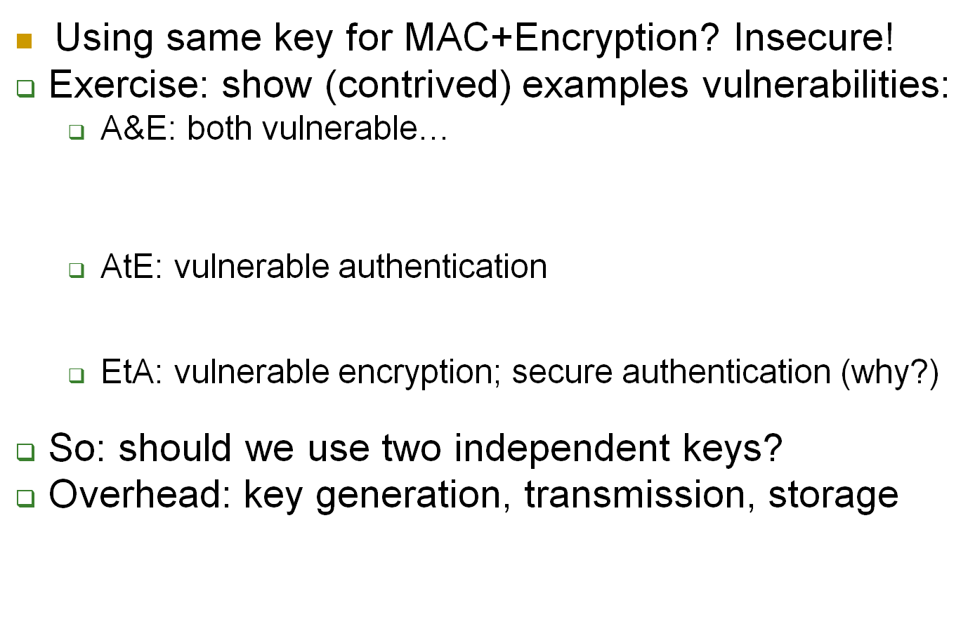
Keys for MAC and Encryption?
Using same key for MAC+Encryption? Insecure!
Exercise: show (contrived) examples vulnerabilities:
A&E: both vulnerable…
AtE: vulnerable authentication
EtA: vulnerable encryption; secure authentication (why?)
So: should we use two independent keys?
Overhead: key generation, transmission, storage
Notes:
34
(c) Amir Herzberg, http://AmirHerzberg.com, Bar Ilan University
11/13/11

Slide 35
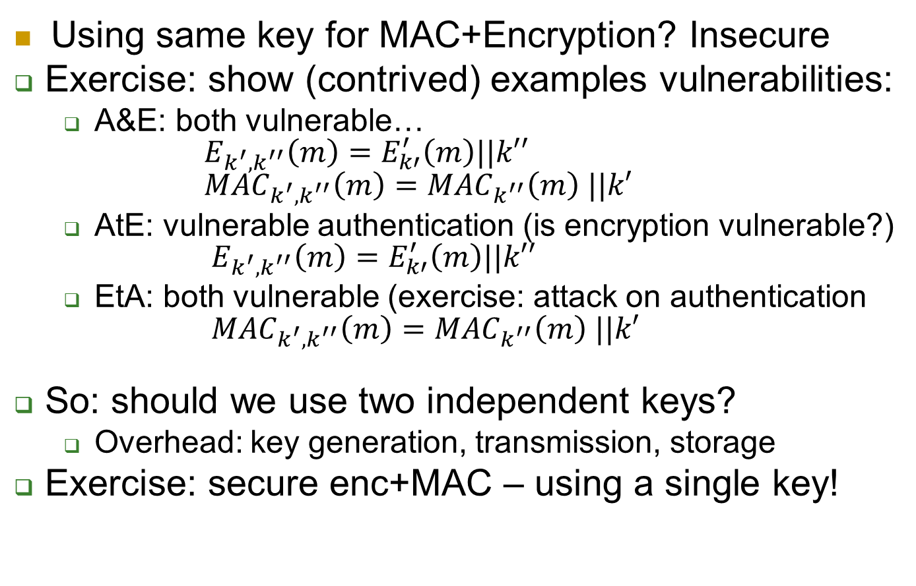
Keys for MAC and Encryption?
Using same key for MAC+Encryption? Insecure
Exercise: show (contrived) examples vulnerabilities:
A&E: both vulnerable… $E_{k^{′},k^{′′}}\left(m\right)=E_{k′}^{′}\left(m\right)||k′′$ ${MAC}_{k^{′},k^{′′}}\left(m\right)={MAC}_{k^{′′}}\left(m\right) ||k′$
AtE: vulnerable authentication (is encryption vulnerable?) $E_{k^{′},k^{′′}}\left(m\right)=E_{k′}^{′}\left(m\right)||k′′$
EtA: both vulnerable (exercise: attack on authentication ${MAC}_{k^{′},k^{′′}}\left(m\right)={MAC}_{k^{′′}}\left(m\right) ||k′$
So: should we use two independent keys?
Overhead: key generation, transmission, storage
Exercise: secure enc+MAC – using a single key!
Solution: k_{mac}:= PRF_{k}(`MAC’), k_{enc}:= PRF_{k}(‘Encrypt’)
Notes:
35
(c) Amir Herzberg, http://AmirHerzberg.com, Bar Ilan University
11/13/11
Attack on auth using EtA, works also for different keys: Forge: Let E’_{k}(m)=E_{k}(m)||MAC_{k}(m+1)

Slide 36
Conclusion
MAC –Message Authentication Code
Sender appends `tag` (MAC) to message, recipient verifies tag using shared secret key
Construction from block cipher
Next:
Crypto-hash functions
Constructing MAC from hash function: HMAC
Block-chains
Notes:
36
(c) Amir Herzberg, http://AmirHerzberg.com, Bar Ilan University
11/13/11

